Slide 1
Digital Portfolio
STUDENT NAME:Aakash kannan.r REGISTER NO AND NMID: U24CA423/0F1018053539D229A0A4F68B3C57DDFF DEPARTMENT: Smart BCA
COLLEGE: Hindustan College of Arts & Science / UNIVERSITY OF MADRAS

Slide 2
PROJECT TITLE
Student Digital Portfolio Using Front End Development

Slide 3


AGENDA
Problem Statement
Project Overview
End Users
Tools and Technologies
Portfolio design and Layout
Features and Functionality
Results and Screenshots
Conclusion
Github Link
3/21/2024 Annual Review

Slide 4

PROBLEM STATEMENT
In todays digital era, traditional resumes alone are not enought to showcase skills and projects effectively. Many students and professional lack a structued online presence to highlight their work.
A digital portfolio provides an interactive and accessible
platform to present achievements, skills, and experience

Slide 5

PROJECT OVERVIEW
Brief summary of your project.
*What your portfolio contains(About Me, Project,Skills,Contact)
*Main idea: Showcase personal achievement, skills, and projects.

Slide 6

WHO ARE THE END USERS?
*Students (academic projects, resumes).
*Job seekers(to share with recurites).
*Freelancers(to show clients)
*Professionals(to highest experience and achievements).

Slide 7
TOOLS AND TECHNIQUES
HTML->Structure (pages,sections).
CSS->Styling (colors,layout,responsiveness).
Javascript->Interactivity (navigation menu, animations, form validation).

Slide 8
POTFOLIO DESIGN AND LAYOUT
*Home/About Me
*Projects
*Skills
*Contact
*Responsive Layout (mobile + desktop view).
‹#›

Slide 9
FEATURES AND FUNCTIONALITY
*Navigation bar with smooth scrolling.
*Project showcase with images/details.
*Interactive elements (hover effects, animations).
*Contact form(with validation).
*Responsive design for all devices.

Slide 10
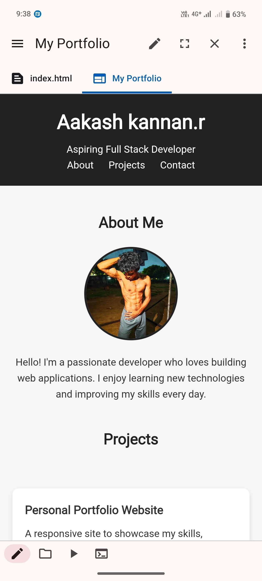
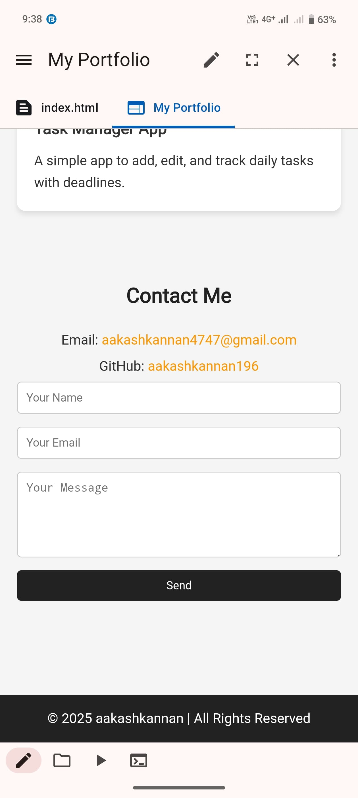
RESULTS AND SCREENSHOTS
1.Successfully created a professional portfolio
2.Demonstrated technical skills in Html,css and Javascript.
3.Responsive and interactive design enhances user experience.
3/21/2024 Annual Review
‹#›

Slide 11
CONCLUSION
The digital portfolio provides a modern and
professional way to showcase skills and
projects. It helps students, job seekers,
and professionals establish a strong online
presence and improl career opportunities.
Github:
https://github.com/aakashkannan196
‹#›

